Slide 1

WORKOUT Example CHM 101

Slide 2


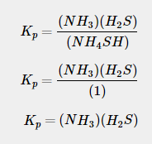
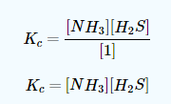
Example 1: Thermal Decomposition of NH4SH(s)NH4SH(s)
Consider the thermal decomposition of NH4SH(s) :This also is related to K_{sp}
but since NH4SHNH4SH is a solid, we get:
As for K_{p}, it is the same as K_{c}, but instead of brackets [ ], K_{p} uses parentheses ( ):

Slide 3
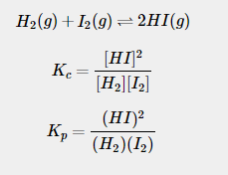
Example 2: Hydrogen and Iodine. Consider the double replacement reaction of hydrogen and iodine gas:

Slide 4

Example 3 Given: NOBr = 0.46 M, NO= 0.1 M, Br₂ = 0.3M
Answer: K_{c}= 0.0142 M

Slide 5
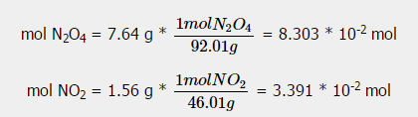
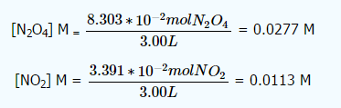

Example 5
N₂O₄ (l) is an important component of rocket fuel, At 25 ∘∘C N₂O₄ is a colorless gas that partially dissociates into NO₂. The color of an equilibrium mixture of these 2 gasses depends on their relative proportions, which are dependent on temperature. Equilibrium is established in the reaction N2O4(g)⇌2NO2(g)N2O4(g)⇌2NO2(g) at 25 °C.
Given: 3.00 L container, 7.64 g N₂O₄1.56 g NO₂
What is the K_{c} for this reaction?
Step 1: Convert grams to moles
Step 2: Convert moles to Molarity (moles/L)
Step 3: Write the Equilibrium constant for K_{c}:

Slide 6


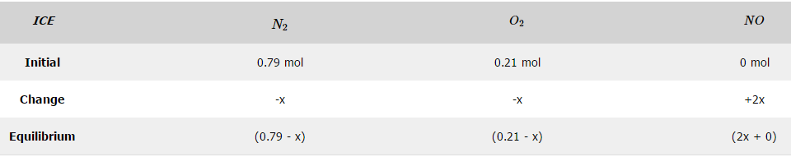
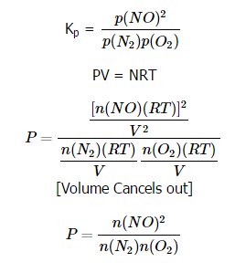
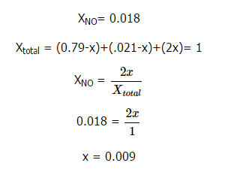
Example 6 Given: N₂= 0.79 moles, O₂ = 0.21 moles, Temp = 2500 K, When equilibrium is established the mole percent of Nitrogen Oxide (NO) at 1.8%.Calculate K_{p} for the reaction
1st step: Create an ICE table:
2nd Step: Find the Mole Percent (%) of products
4th Step: Plug in values

Slide 7
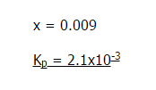

4th Step: Plug in values

Slide 8
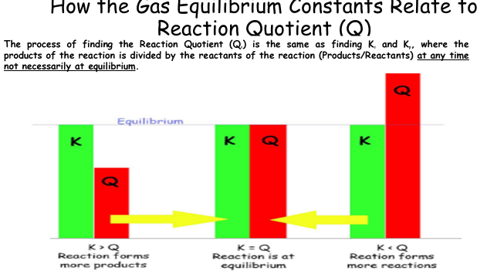

Slide 9
How the Gas Equilibrium Constants Relate to Reaction Quotient (Q)
A trick to remember to which what the reaction will favor is: Put:
K _ Q (in alphabetical order! - or it will not work)
K < Q : K ←← Q
The reaction will favor the reactants because reactants are on the left of the equation.
K > Q : K →→ Q
The reaction will favor the products because products are on the right of the equation.
K = Q : NO CHANGE

Slide 10




Heterogeneous Equilibria: Reactants/Products in more than one phase. For example:
The relationship between the two equilibrium constants are:
Δn = (Total moles of gas on the products side) - (Total moles of gas on the reactants side). Hence \( \Delta = (d + c) - (a + b)\] [The lower case numbers are the exponents]
R is the gas constant found in the

Slide 11






Kc is an equilibrium constant in terms of molar concentrations and is usually defined as:
in the general reaction,
If a large Kc is formed then there are more products formed. Inversely, a small Kc indicates that the reaction favors the reactants. Kp is an equilibrium constant in terms of partial pressures. and is usually defined as:
for the general reaction
Homogeneous Equilibria: Reactants/Products all in a single phase. For example:

Slide 12


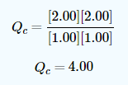
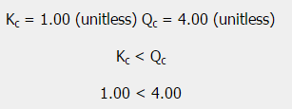
Example 7: Relating K to Q
Given: K_{c} = 1.00 at about 1100 KCO = 1.00 mol H₂O = 1.00 mol CO₂ = 2.00 mol H₂ = 2.00 mol.
Compared with their initial amounts, which of the substances will be present in a greater amount and which is in a lesser amount when equilibrium is established?
Step 1: Write out the expression for Q_{c}
Step 2: Plug in the number of Molarity, since volume is not given, assume it is 1 Liters
Step 3: Compare K_{c} with Q_{c}
Therefore, the reaction will shift to the LEFT towards the reactants.

Slide 13



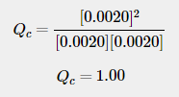
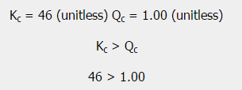
Example 8
A mixture of hydrogen, iodine, and hydrogen iodide, each at 0.0020 M, was introduced into a container heated to 783 Kelvins. At this temperature Kc=46, Predict if more HI or less will be formed.
Step 1: Write out the reaction
Step 2: Write out the expression for Q_{c}
Step 3: Plug in the Molarity given
Step 4: Compare K_{c} with Q_{c}
The reaction will shift to the RIGHT towards the products. Therefore, more HI will be produced.

Slide 14

Below are practice problems for K_{c} and K_{p}:
Gaseous Hydrogen Iodide is placed in a closed container at 425 ∘∘C, Where it partially decomposes to Hydrogen and Iodine:
What is the value of K_{c} at this temperature?
3. Determine values of K_{c} from the K_{p} value given: (number 7 from p. 655 in the textbook)
K_{p}
1. Write the K_{p} for the reaction and state where the reaction is Homogeneous or Heterogeneous.

Slide 15

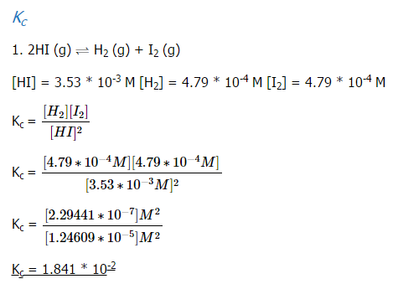
3. The two common chlorides of Phosphorus, PCl₃ and PCl₅, both important in the production of other phosphorous compounds, coexist in equilibrium through: (number 17 from p. 655 in the textbook)
At 250 ∘∘C, an equilibrium mixture in a 2.50 L flask contains 0.105 g PCl₅, 0.220 g PCl₃, and 2.12 g Cl₂. What are the values of (a) Kc and (b) Kp for this reaction?

Slide 16
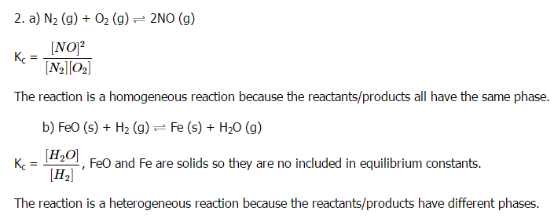
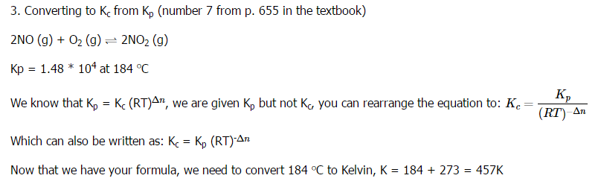

Slide 17
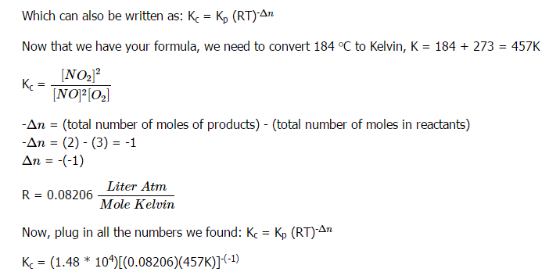
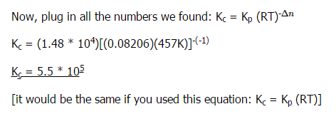

Slide 18
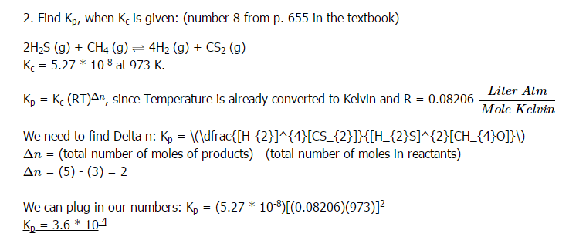
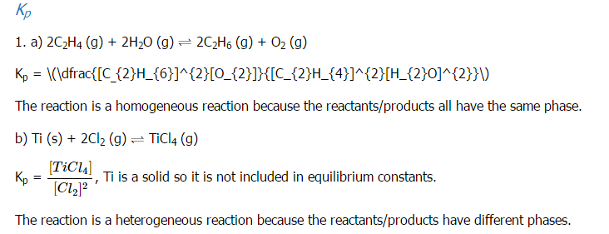

Slide 19
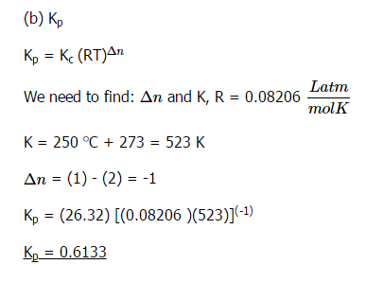
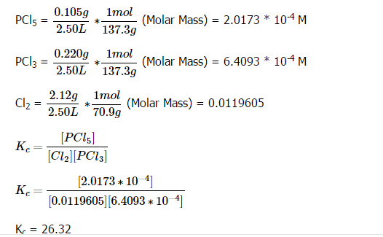
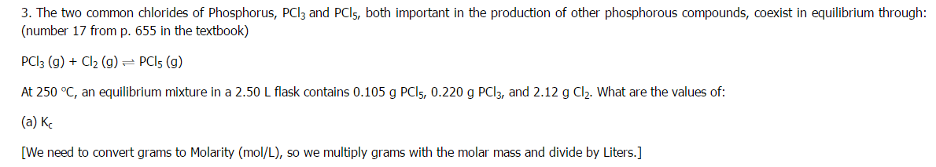

Slide 20




The value of K depends on whether the solution being calculated for is using concentrations or partial pressures. The gas equilibrium constants relate to the equilibrium (K) because they are both derived from the ideal gas law (PV = nRT).
KcKc is the concentration of the reaction, it is usually shown as:
KpKp is the amount of partial pressure in the reaction, usually shown as:
We know that Partial Pressure is directly proportional to Concentration:

